Slide 1


weTweet
B.J.b. autonomous college
Subhalaxmi behra
71924532
Avinash kumar
71924522
Guided by:-
Er. amresh kumar mohanthy
Lokesh jha
71924533

Slide 2
contents
introduction
Feasibility study
System requirement
Use case and dfd
Technology used
features
conclusion

Slide 3

introduction
Here user can expand their social network and stay updated what is trending now.
It facilitates the sharing of ideas thoughts information among different communities.

Slide 4
Feasibility study
Preliminary investigation examines project feasibility likelihood the app will be helpful to the user
The main objective of feasibility study is to test the technical, operational , , economical feasibility for adding new modules and debugging the old running system .
Since we are using technology such as react js, node js, html, css, javascript which are available free of cost so this project is financially and technically feasible.

Slide 5
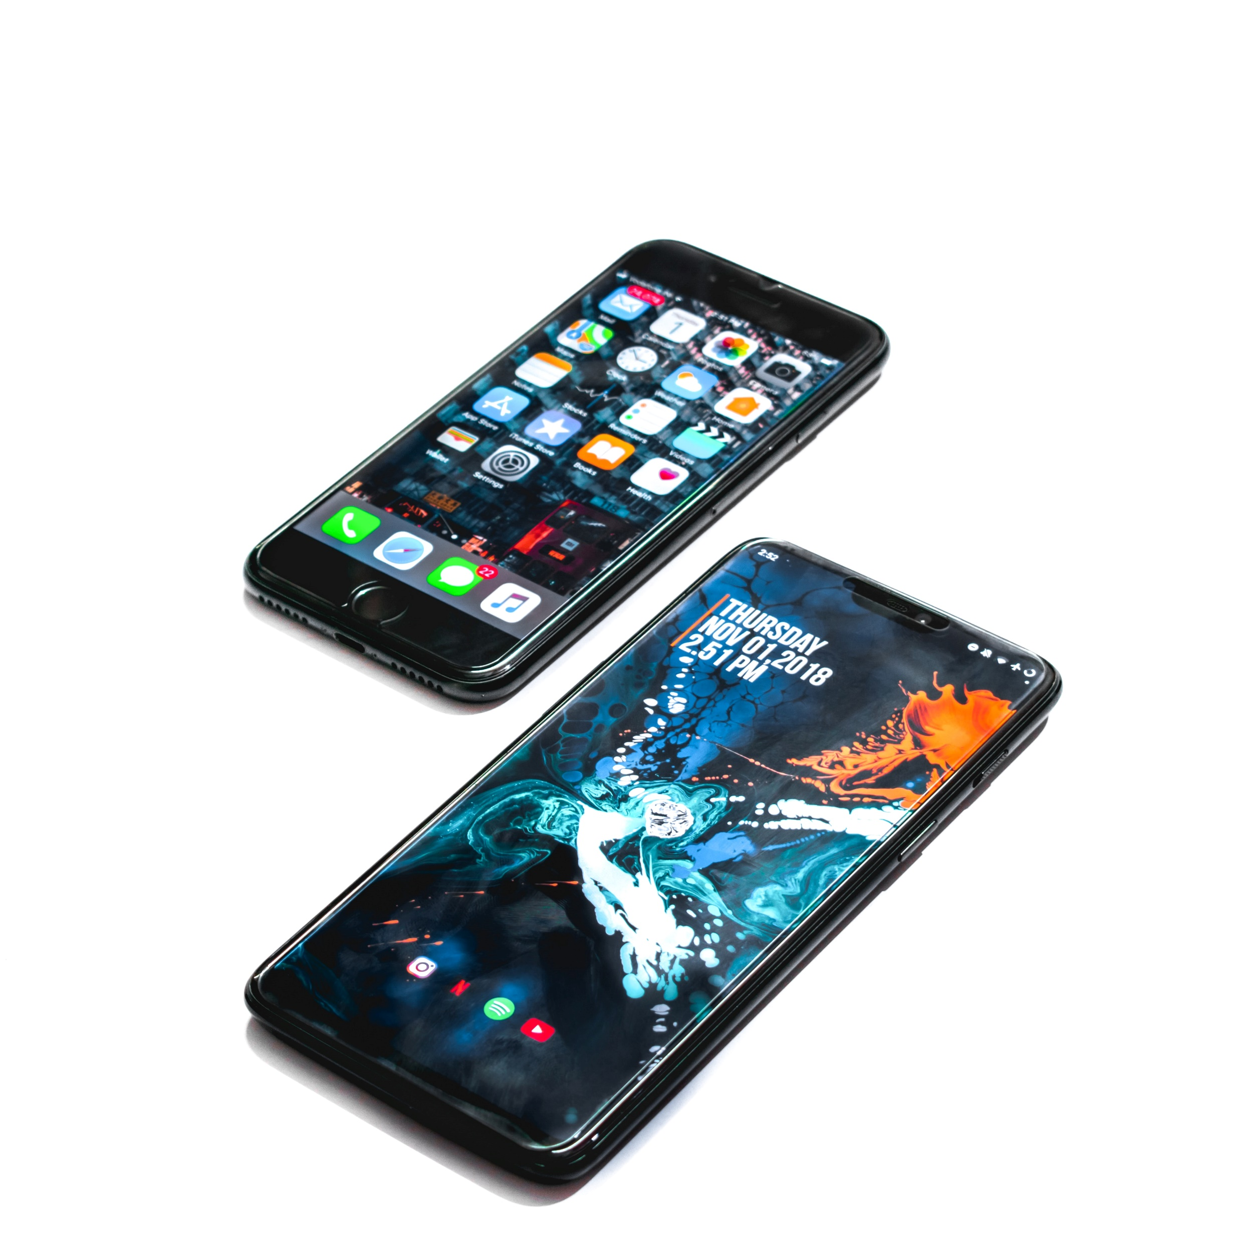

System requirement
Hardware requirement:-
Minimum RAM : 1GB
Recommended RAM : 4GB
Processor : 1GHz or above
Hardrive:- 64 GB or above
software requirement:-
Operating system: windows XP or above

Slide 6
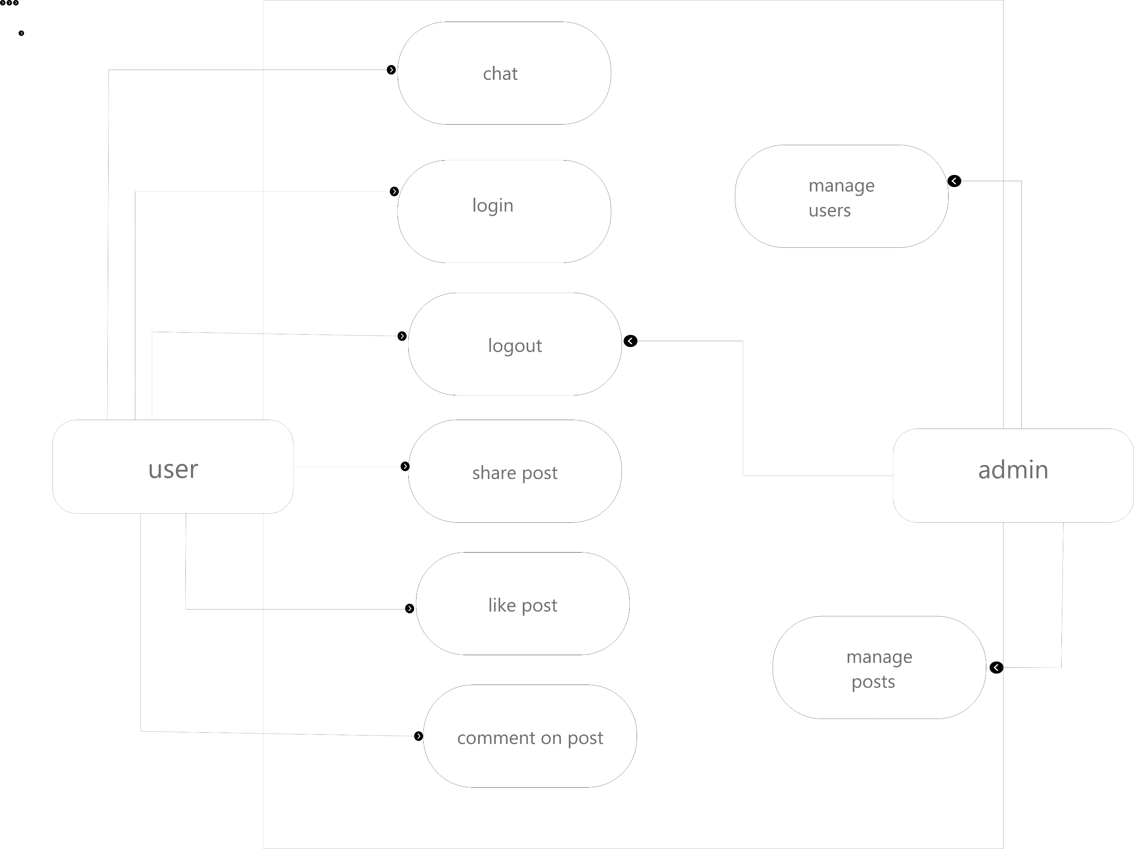
Use case

Slide 7
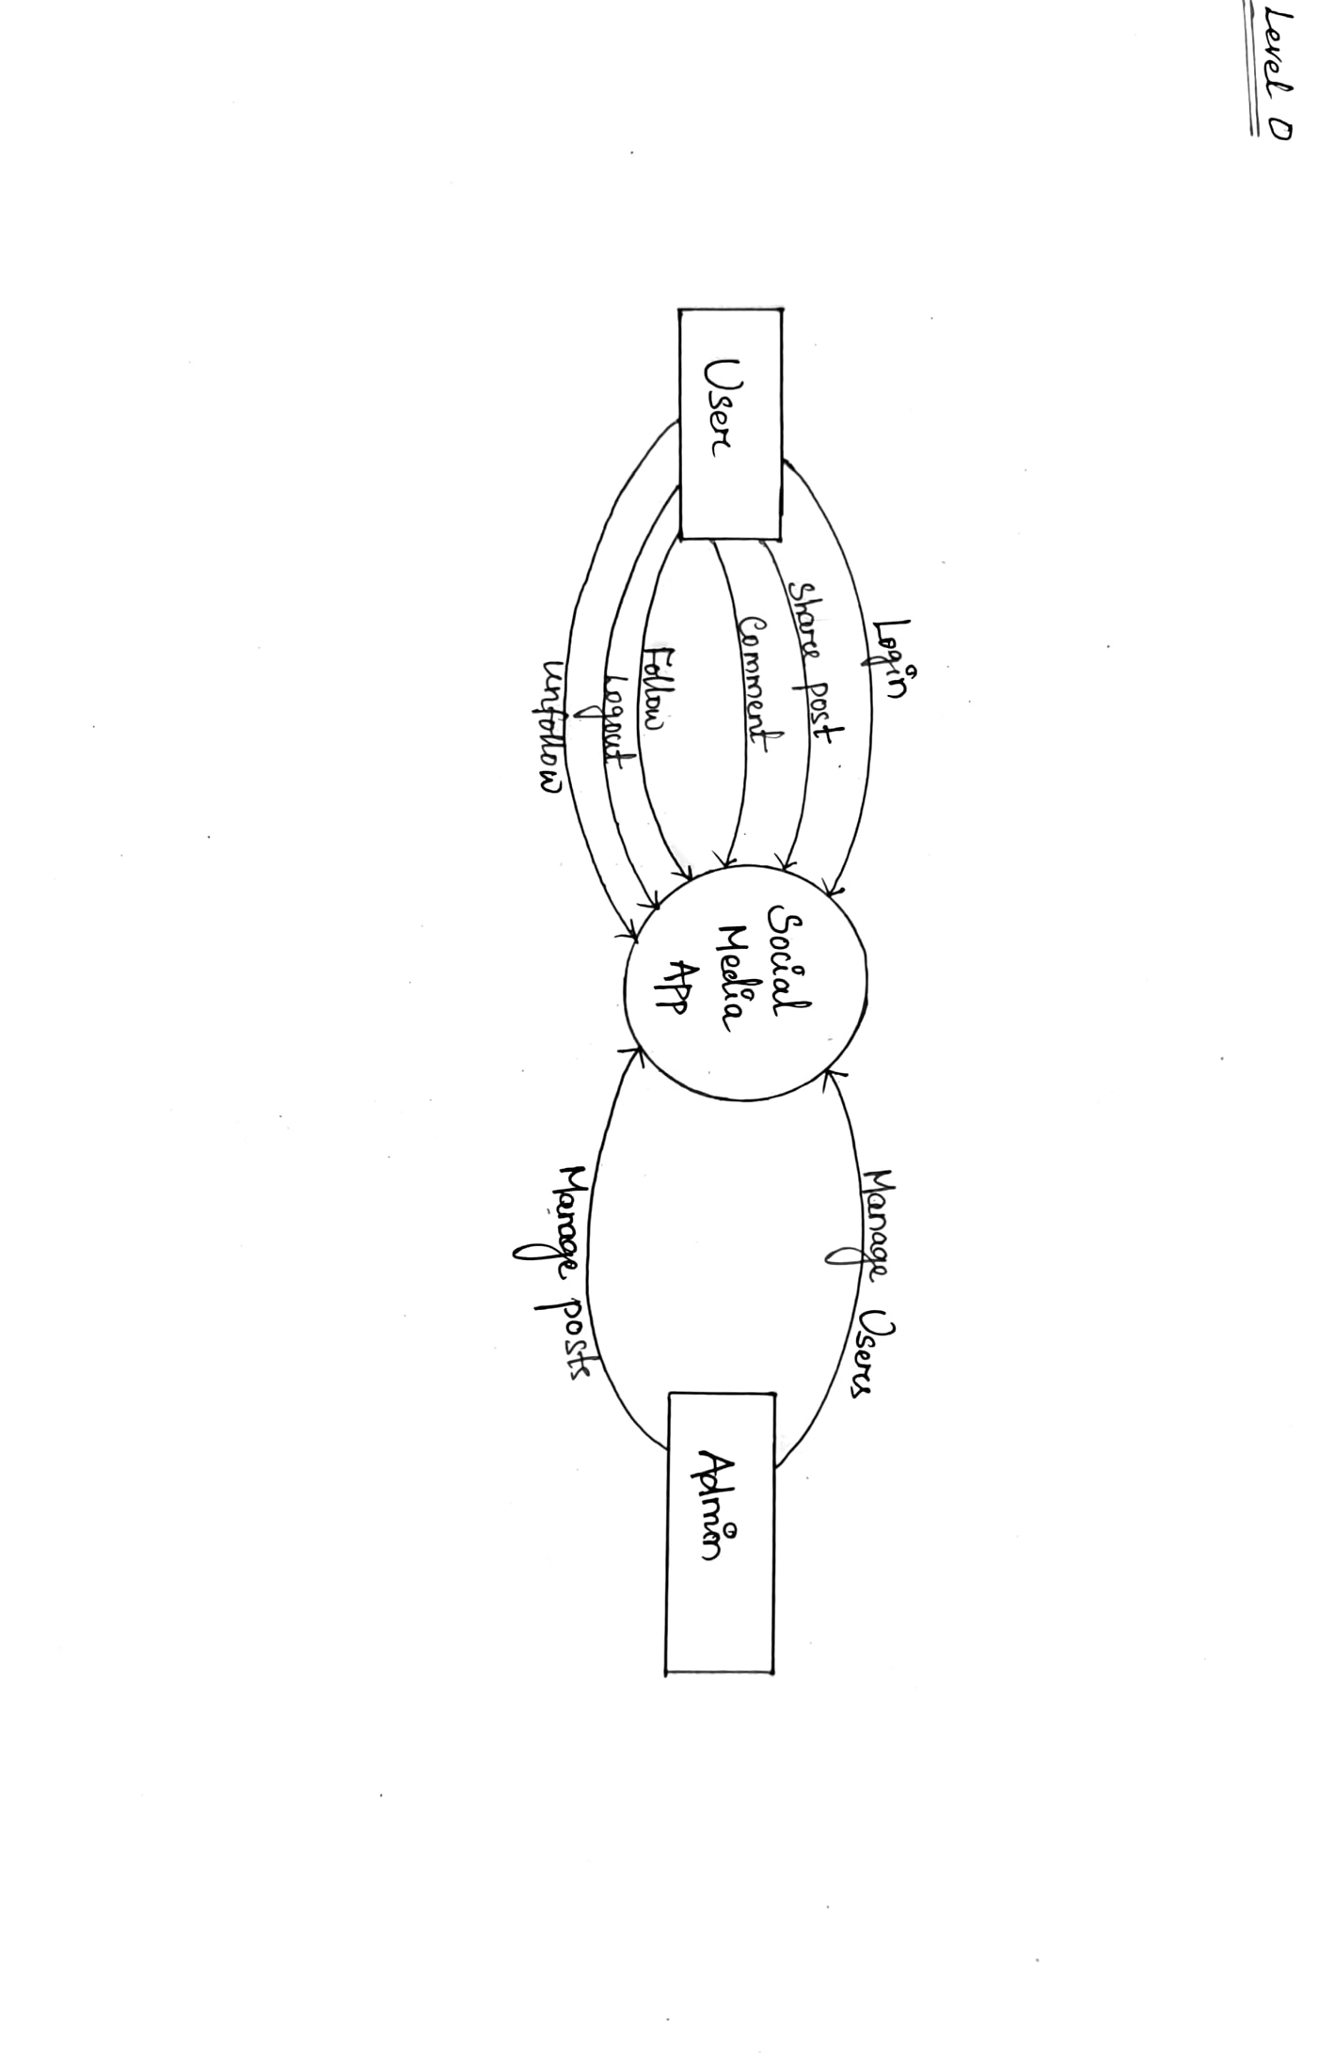
Dfd diagram

Slide 8
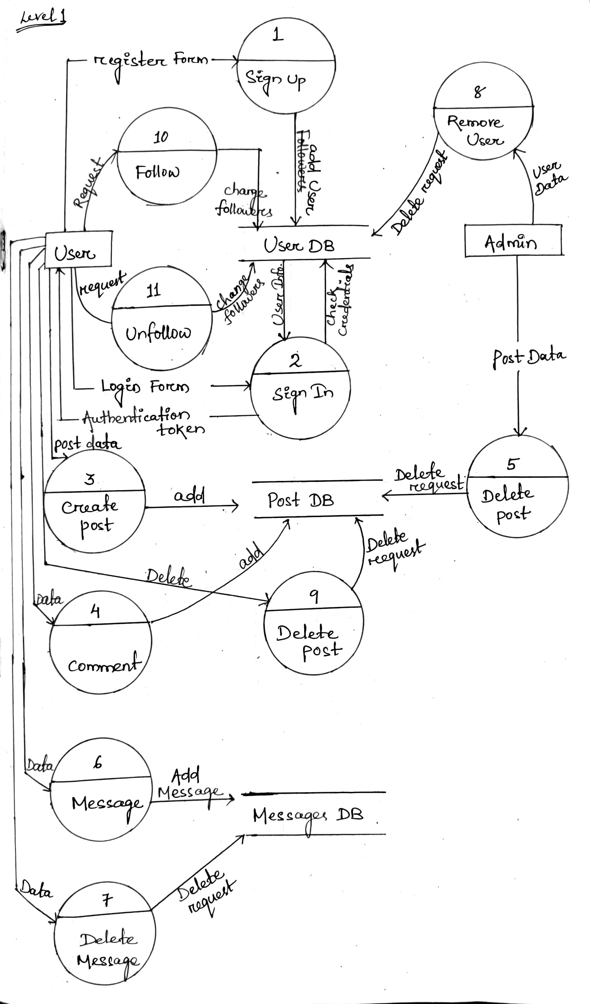

Slide 9

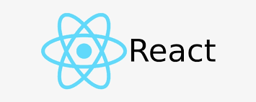




Technology used:-

Slide 10
Features
Simple and friendly user interface
Visual appealing and accessible design
Secure login
Content sharing method
Open forum
Real time notification

Slide 11
conclusion
A successful platform will be developed which will facilitates user with various advantages like sharing their thoughts with multiple people and will able to get updated with the latest trends.
This platform will ensure the safety of users privacy
This will be the interactable junction for the users .

Slide 12
…….Thank you…….

